Slide 1
Chapter 10: Pathogens

Slide 2
What is disease?
Definition of disease
A disease is any condition that interferes with how an organism, or any part of it, functions.
An endemic disease is common in a population at a low level.
An outbreak is a sudden increase in the incidence of a disease in a population.
Many diseases are caused by an infectious agent, called a pathogen.
The infected organism is called the host.

Slide 3
What is disease?
Classifying diseases
Diseases can be grouped according to their cause:
Infectious diseases caused by an agent, or pathogen, that can be passed from one organism to another (bacteria, viruses, fungi, parasites, prions)
Non-infectious diseases not caused by a pathogen and non-communicable (e.g. obesity, osteoporosis, Alzheimer's disease)
Genetic diseases due to mutations inherited from parents (e.g. Cystic fibrosis, haemophilia)
Autoimmune diseases caused by the immune system targeting cells or tissues body (host, or ‘self’) (e.g. lupus, multiple sclerosis, rheumatoid arthritis)

Slide 4
The nature of disease
Most micro-organisms are not pathogens. Pathogens have special characteristics, such as the ability to evade the host immune response, stick to, or invade, specific cells or produce toxins.
Parasites are pathogens that benefit at the expense of the host.
Pathogenicity The potential disease-causing capacity of a pathogen
Virulence The degree of pathogenicity of a pathogen
Individuals can differ in their susceptibility to a particular disease and some may show a greater resistance to disease.

Slide 5
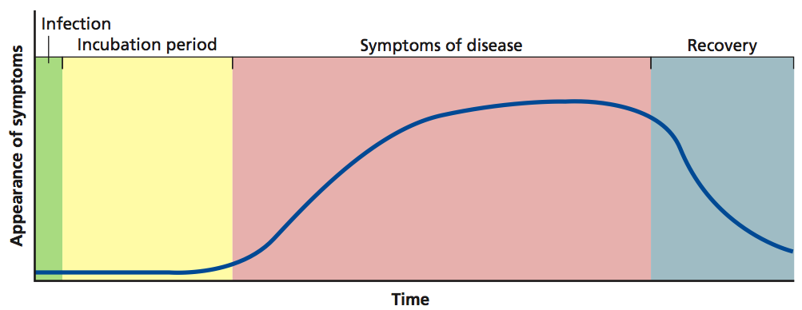
Symptoms
The nature of disease
Symptoms are the effects a pathogen or disease has on the body of the host (e.g. high temperature, rash, cough, lethargy).
Pathogens often require an incubation period before symptoms develop. This may be because:
        They need to divide multiple times to reach sufficient numbers
        They need time to reach their target organs/tissues/cells
        Toxins produced by the pathogen accumulate over time
        It is common for the host to be contagious before symptoms develop.
Figure 10.3
Figure 10.3

Slide 6
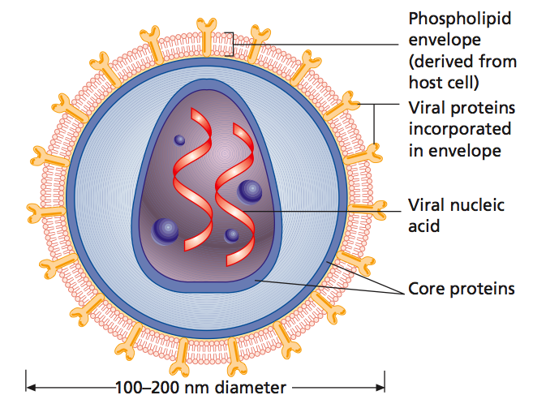
Viruses
Non-cellular agents as pathogens
Non-cellular agents comprised of a protein coat and a nucleic acid genome (either RNA or DNA).
Examples of DNA and RNA viruses
DNA viruses | RNA Viruses
Herpes simplex virus | Influenza
Hepatitis B | SARS
Smallpox | Hepatitis C
Epstein-Barr virus | Ebola
Figure 10.4

Slide 7
Viruses – life cycle
Non-cellular agents as pathogens
Viruses are obligate intracellular parasites – they rely totally on host cells for their reproduction.
Virus infects host
Injects nucleic acid into cell
Production of new viral coat proteins and nucleic acids
Cell lyses or splits open – viruses are released
Assembly of new virus

Slide 8
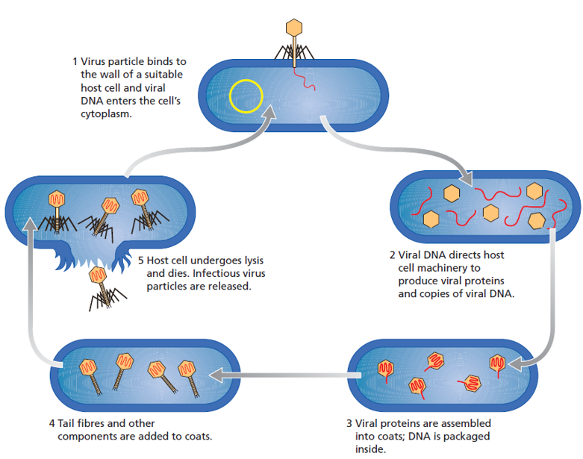
Viruses – life cycle
Non-cellular agents as pathogens
Viruses that infect bacteria are called bacteriophages.
Figure 10.6

Slide 9
Viruses – life cycle
Non-cellular agents as pathogens
Lysogenic phase Viral nucleic acid is incorporated into host chromosome and is replicated as the host divides. The virus remains latent and undetected.
Lytic phase Viral nucleic acids replicate separately from the host chromosome and produce new viral particles and lyse the host cell wall.
Viruses are highly specific for the cell or organism they infect: an adenovirus infects lung epithelial cells, causing the common cold.
Bacteriophages infect only bacteria.

Slide 10
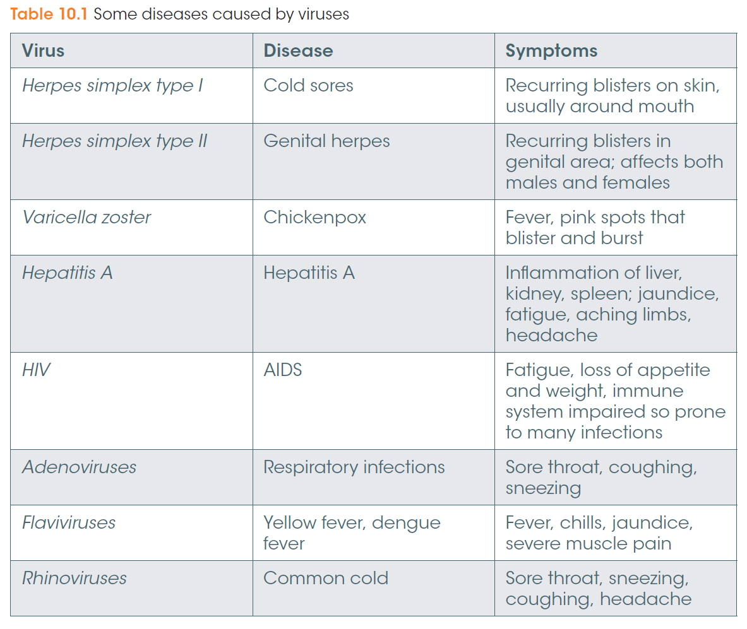
Non-cellular agents as pathogens

Slide 11
Prions
Non-cellular agents as pathogens
Prions are small infectious proteins in the brain. Because they are proteins they do not contain genetic material.
The prion protein exists normally in the body. It plays a role in memory, learning and intercellular signaling. It can be converted to a disease-causing form.
Two forms:
  PrP^{c} = normal protein
  PrP^{Sc} = disease-causing form
PrP^{Sc} is able to convert PrP^{c} to the harmful PrP^{Sc}.

Slide 12
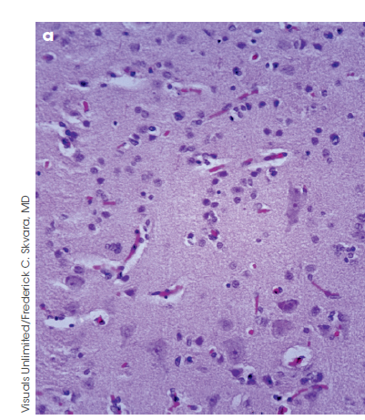
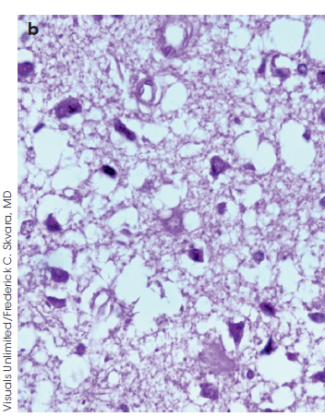
Prions
Non-cellular agents as pathogens
The harmful PrP^{Sc} proteins accumulate and aggregate to form filaments. These kill brain cells, affecting muscle coordination and brain function.
Prions cause:
  Mad cow disease (BSE) in cows
  Scrapie in sheep and goats
  Creutzfeldt-Jacob disease in humans
Normal brain biopsy
CJD brain biopsy
Figure 10.9

Slide 13
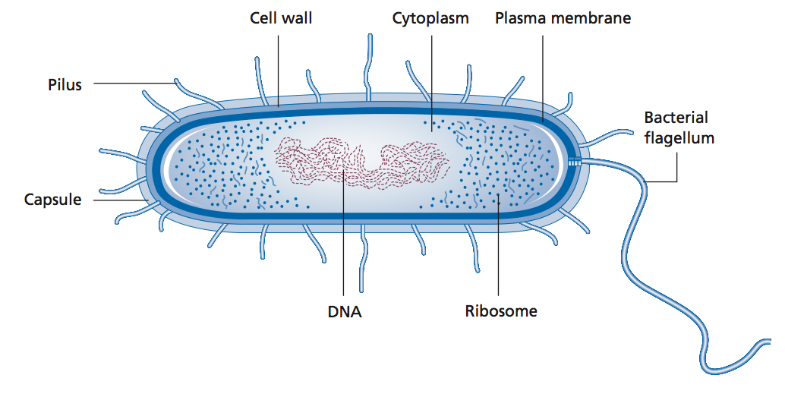
Bacteria
Cellular agents as pathogens
Only a relatively small number of bacteria cause disease. Billions of commensal bacteria live on and in our bodies and are often beneficial.
Bacteria often have a cell wall containing peptidoglycan outside their cell membrane.
Some have a flagellum, which gives them motility.
Some have a slimy bacterial capsule.
Figure 10.10

Slide 14
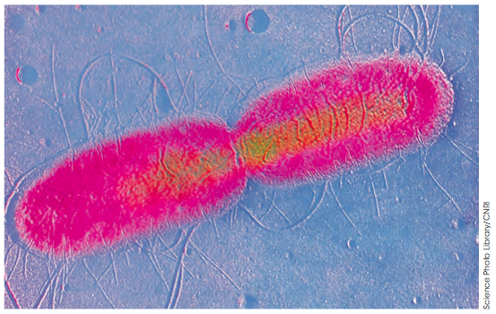
Bacteria
Cellular agents as pathogens
Bacteria reproduce by binary fission or by forming spores.
Some species can reproduce every 20 minutes. From one bacterium,
4.7 × 10²¹ new bacterial cells can be produced in 24 hours.
Figure 10.11

Slide 15
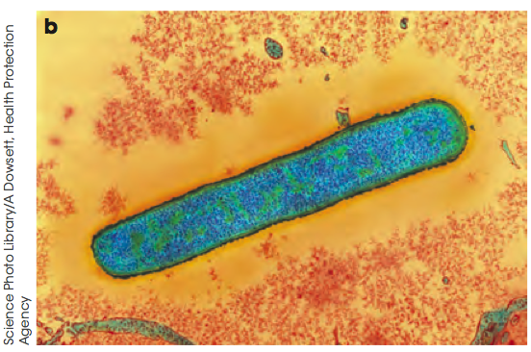
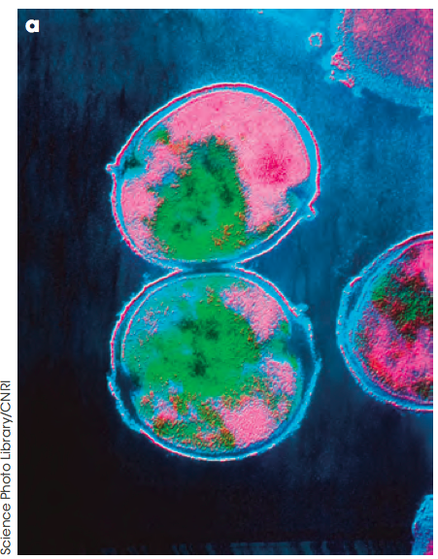
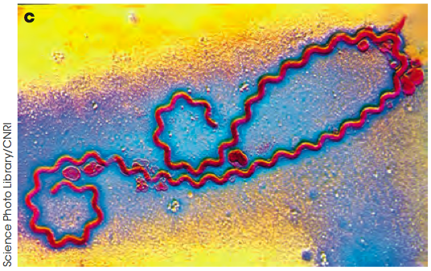
Bacteria
Cellular agents as pathogens
Bacteria can be classified according to their shape and whether they cluster together.
A rod-shaped bacterium is a bacillus
(pl. bacilli)
A spherical bacterius is a coccus
(pl. cocci)
Spiral bacteria (pl. spirilli)
Diplococci occur in pairs
Streptococci occur in chains
Staphylococci occur in clusters
Vibrio bacteria are shaped like a comma
Figure 10.12

Slide 16
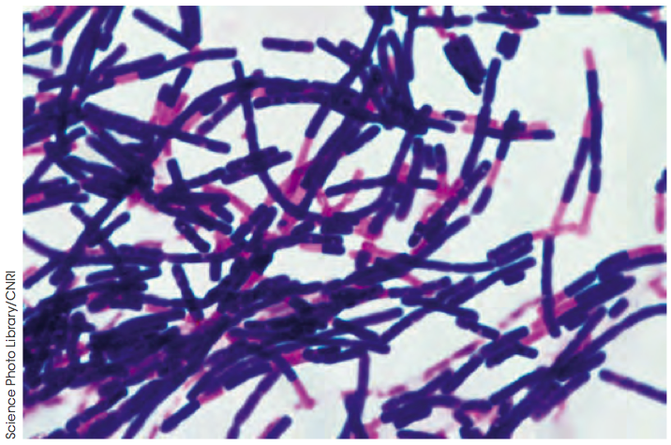
Bacteria
Cellular agents as pathogens
Different species or strains of bacteria can be difficult to distinguish under a
microscope.
One useful test for identifying bacteria is the Gram stain which can stain different strains purple or pink depending on their cell membrane/cell walls.
Figure 10.13

Slide 17
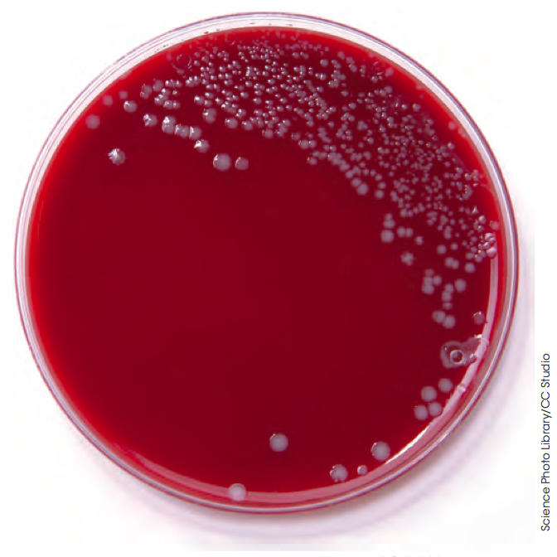
Bacteria
Cellular agents as pathogens
Bacteria can be grown as colonies, which contain clones of the original bacterial cells.
First, bacterial cells are ‘streaked’ onto an
agar plate.
Single colonies, originating from a single bacterium and containing identical cells, can
be picked off and inoculated into a liquid medium broth.
The appearance of colonies and the nutrients they require to grow vary between species.
Figure 10.14

Slide 18
Bacteria
Cellular agents as pathogens
Bacteria can have properties that make them pathogenic to other organisms.
Components of bacterial cells are sometimes highly pathogenic, especially external components such as lipopolysaccharides and peptidoglycans.
Bacteria can produce toxins (often bacterial metabolic wastes) that damage host tissues or interfere with the host’s immune system.

Slide 19
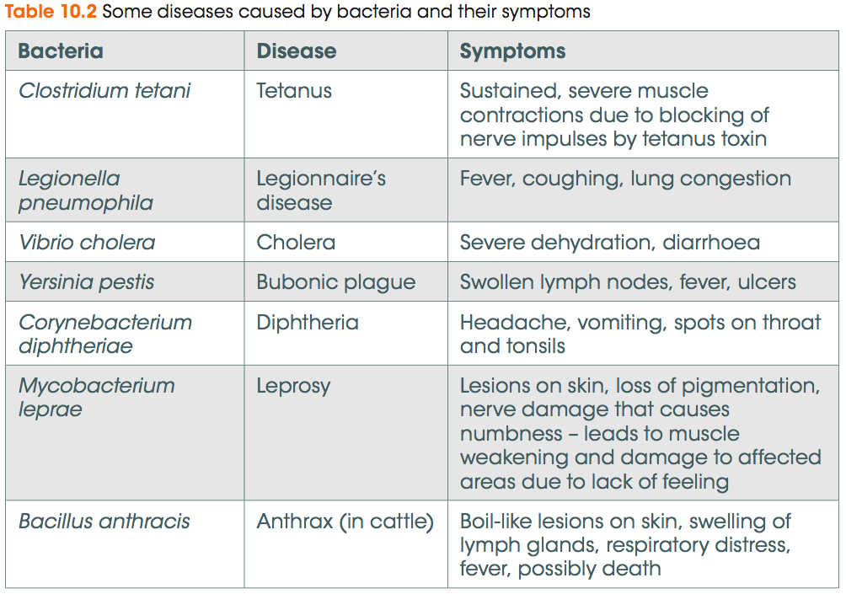
Cellular agents as pathogens

Slide 20
Fungi
Cellular agents as pathogens
As well as mushrooms and toadstools, fungi include microscopic forms – unicellular yeasts and moulds.
Fungi are eukaryotes and are usually larger than bacteria.
They reproduce using spores.
Fungi have a cell wall made of chitin.
As disease causing agents, fungal diseases are usually external, infecting and irritating the skin.
Examples of fungal diseases are tinea and ringworm, where spore-infected skin flakes off, spreading the infection.
Fungal infections can cause serious disease in plants and in immunocompromised individuals.

Slide 21
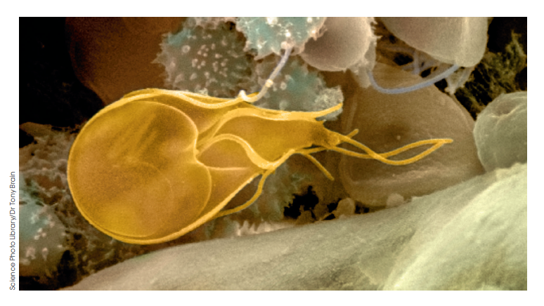
Protists
Cellular agents as pathogens
Protists are unicellular, eukaryotic organisms that produce sexually and asexually.
Very few species cause disease in humans, but those that do can cause serious illness.
Examples include:
Malaria
Trypanosoma
Giardia
Amboebic dysentery
Cryptosporidiosis
Figure 10.16

Slide 22
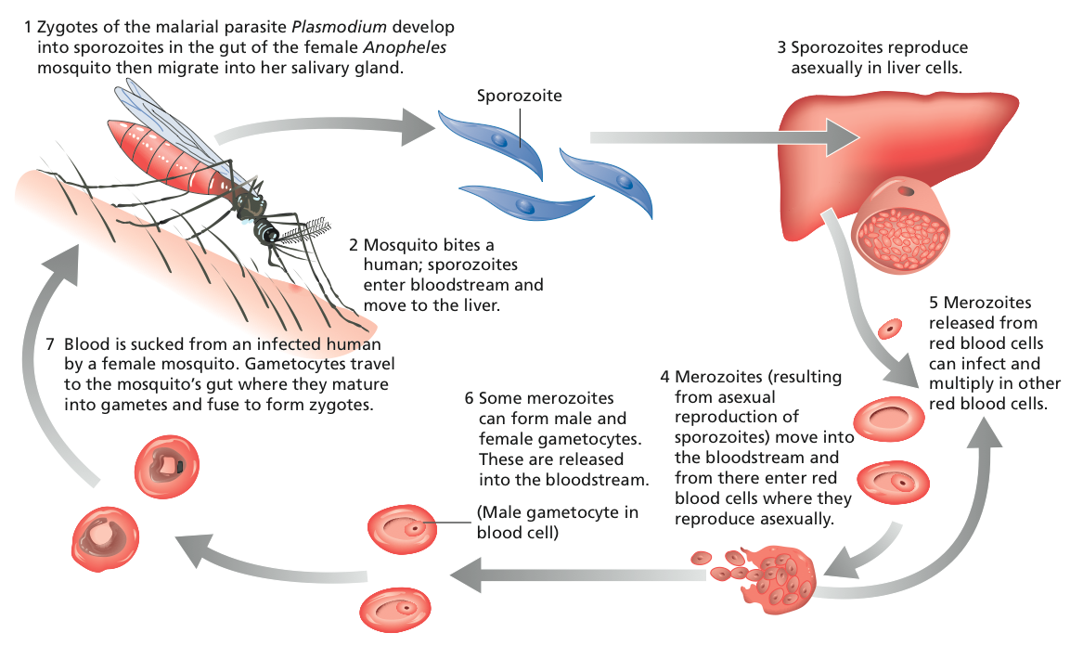
Protists
Cellular agents as pathogens
The lifecycle of malaria
Figure 10.17

Slide 23
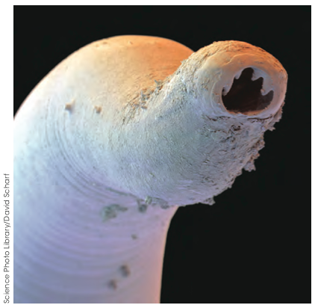
Endoparasites
Cellular agents as pathogens
Many parasitic flatworms, roundworms and flukes are endoparasites of animals, and plants can also be infected. A female Ascaris worm can produce 200 000 eggs a day or 25 million eggs over her lifetime of 12-18 months.
The intermediate host is where the parasite develops but does not reach sexual maturity.
The definitive host is where the adult form of the parasite produces gametes.
Some endoparasites have a direct life cycle, completing development in a single host.
Juvenile forms of the parasite can encyst in tissues, where they can be ingested by the next host.
Figure 10.18

Slide 24
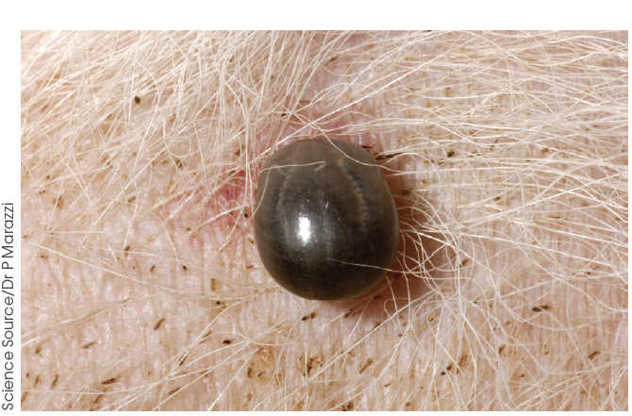
Ectoparasites
Cellular agents as pathogens
Ectoparasites live on the surface of their host.
The most common group are arthopods and include fleas, ticks and lice.
Most create only minor symptoms that can be easily treated. However, they can act as vectors for dangerous pathogens including the Yersinia bacterium that causes bubonic plague.
Figure 10.19

Slide 25
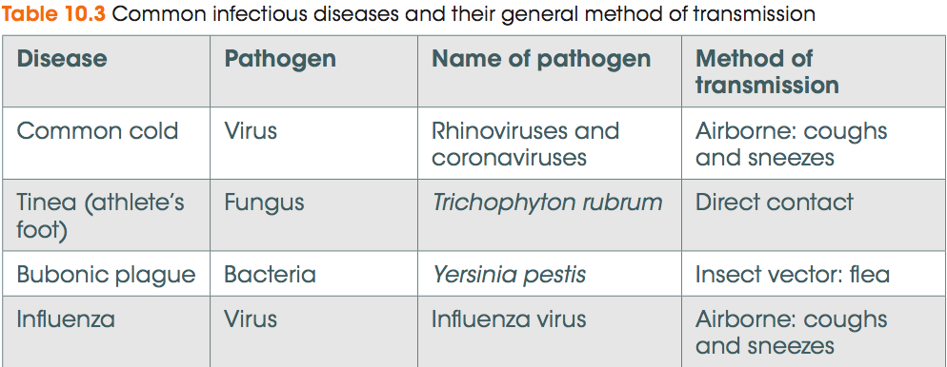
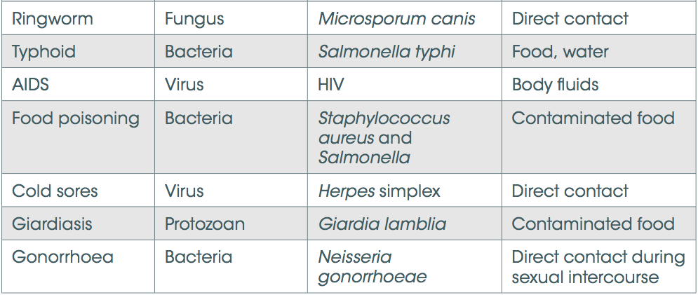
Forms of transmission
To persist and survive, pathogens must follow a repeating cycle of transmission from current to future host.

Slide 26
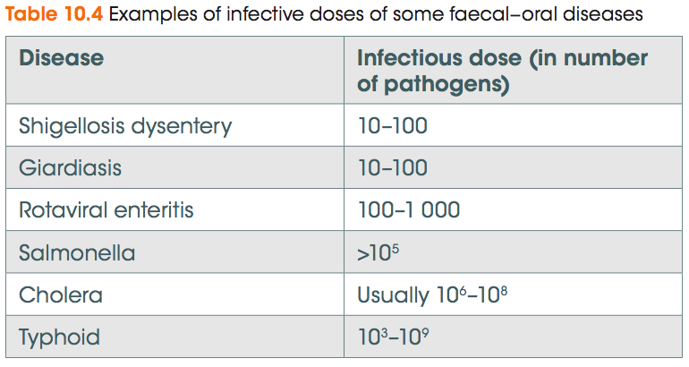
Forms of transmission
Pathogens have a range of adaptations to enable their transmission between hosts.
One adaptation is having a very low infective dose, that is, the number of organisms needed to establish in a new host.

Slide 27
Transmission by direct contact - examples
Forms of transmission
Pathogen | Adaptation for transmission
Herpes simplex (cold sore virus) | Pathogen reproduction involves formation of fluid filled lesions containing millions of pathogens.
Varicella zoster (chicken pox virus) | Involves formation of itchy virus-filled pox. The virus is released when the lesions are scratched.
Staphylococcus aureus (impetigo) | Blisters pop and release the highly infectious bacteria.
Conjunctivitis | The host is compelled to rub the eyes. The virus or bacteria is spread on the hands.
Sarcoptes scabiei (scabies) | Scabies is characterised by intense itching. Scratching releases eggs onto the skin surface.
Enterobius vermicularis (pinworm) | The female lays her eggs on the skin around the anus. People scratch their anus and eggs are picked up under the fingernails, aiding transmission.

Slide 28
Transmission by direct contact
Forms of transmission
Many organisms have adapted to have an infectious period before symptoms show.
In this infectious period, the host may be normally active, interacting with many potential new hosts and maximising the opportunity for transmission of the pathogen.

Slide 29
Transmission by direct contact
Forms of transmission
A zoonotic disease is one that can be transmitted between animals and humans. Ringworm is an example.
New zoonoses can be particularly dangerous as people may have little immunity to them.
An example of transmission that does not use direct contact is when a fomite is involved. This is a non-living object such as bedding, towels and coins that can carry disease-causing organisms.

Slide 30
Transmission by body fluids
Forms of transmission
Mucous from a person with a cold can be teeming with cold virus. Shaking hands with another person can pass the infection on if that person then touches their nose or mouth.
Body fluids include sweat, tears, vomit, mucus, blood, saliva and urine.
Organisms that use this mode of transmission can usually survive outside the body for long periods. They include the pathogens that cause:
glandular fever
cytomegalovirus
sexually transmitted diseases including HIV, hepatitis B, human papillomavirus, gonorrhoea and chlamydia.

Slide 31
Foodborne transmission
Forms of transmission
The gastrointestinal tract is a relatively easy point of entry for a pathogen.
Bacteria like Salmonella, Campylobacter, Escherichia coli and Staphylococcus aureus and viruses like norovirus, hepatitis A and rotavirus cause these food-borne illnesses.
Watery diarrhoea, nausea and vomiting help to transmit the pathogen and low infective doses (e.g. 100 to 10 000 gastroenteritis rotavirus particles) make these diseases easily transmissible.
Between the temperature danger zone of 5-60°C, disease-causing bacteria can divide by binary fission to make many copies of themselves.
It is important to keep food either colder or warmer than this.

Slide 32
Waterborne transmission
Forms of transmission
Several important diseases are transmitted in contaminated water, including diseases transmitted by the faecal-oral route.
Examples include:
bacterial diseases: typhoid, cholera and Shigella
viral diseases such as Hepatitis A
protists: Giardia, Cryptosporidium, Entamoeba
endoparasites such asintestinal worms and Schistosoma
  Juvenile forms live in water and secrete enzymes that break down skin, allowing them to enter the bloodstream of their new host
Improved hygiene, clean water for drinking and washing and good sewerage systems can prevent the transmission of these diseases.

Slide 33
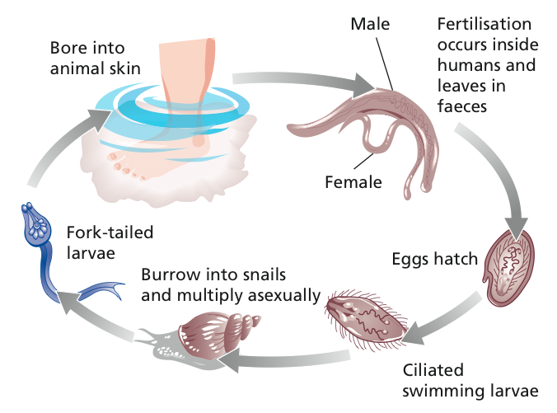
Waterborne transmission
Forms of transmission
The life cycle of Schistosoma japonicum
Figure 10.21

Slide 34
Airborne transmission
Forms of transmission
Airborne diseases include:
measles
mumps
SARS
tuberculosis
colds
Influenza.
Coughing and/or sneezing releases millions of microbes in droplets of mucus or saliva. Particles can remain suspended in air for some time and travel long distances.
The advent of air-conditioning aided the spread of airborne diseases, including Legionnaires Disease.

Slide 35
Transmission by vector
Forms of transmission
A vector is a living organism that transmits pathogens from one host
to another.
Sometimes a pathogen completes part of its life cycle in the vector.
Vectors allow pathogens to:
come into contact with a new host
spread over much greater distances
penetrate the outer defences of the host.
Biting insects such as mosquitoes, ticks, fleas, lice and flies are examples
of vectors.

Slide 36
Transmission by vector
Forms of transmission
Diseases spread by vectors include:
the Hendra virus, in which humans are infected by coming into contact with body fluids of an infected horse. Bats are the vector for this virus.
the bubonic plague (of which there are still 1000-2500 cases a year) is caused by the bacteria Yersinia pestis, spread by fleas.
lyme disease, caused by Borrelia spp. and spread by deer ticks.
mosquitoes are vectors for several diseases, including malaria, yellow fever, and Wuchereria bancrofti, a filarial roundworm.

Slide 37
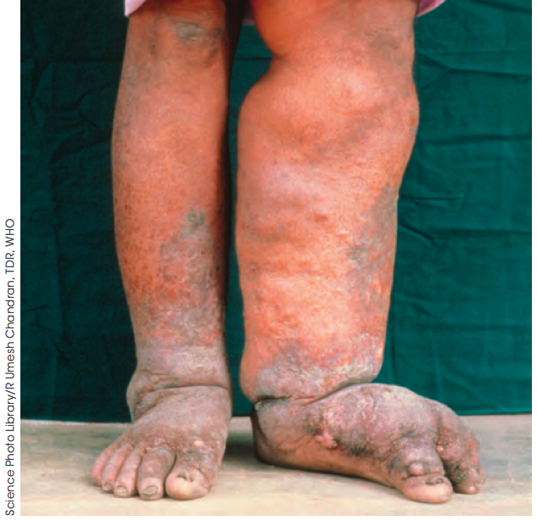
Transmission by vector
Forms of transmission
Wuchereria bancrofti
Adult worms become lodged in lymph nodes and obstruct the flow of lymph fluid.
Accumulation of lymph in legs and other regions causes them to become grossly enlarged.
Figure 10.22
Female Wuchereria produce juveniles that circulate in the bloodstream at night. Mosquitoes that bite an infected individual pick up the juveniles.
In the mosquito, the parasites eventually move to the proboscis, ready for injection into the next human host.

Slide 38
Transmission by vector
Forms of transmission
Trypanosoma brucei
Trypansoma is a protist pathogen that causes sleeping sickness in humans.
Its vector is the tse tse fly and other hosts include African herd animals.
In the first stage of trypanosomiasis, the circulatory and lymphatic systems are invaded by the pathogen and cause intense headaches, joint pains, fever and enlarged lymph nodes.
The parasite also infects the nervous system, causing the desire to sleep.
The tse tse fly bites the host and injects the parasite into the bloodstream.
The parasite multiplies in the blood and lymph and may move to the cerebrospinal fluid.

Slide 39
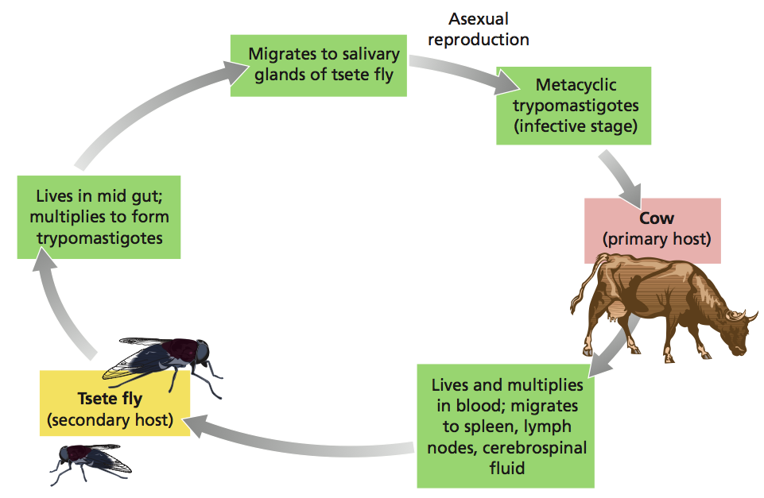
Transmission by vector
Forms of transmission
Trypanosoma brucei – life cycle
Figure 10.23

Slide 40
Controlling disease spread
Forms of transmission
Understanding a pathogen’s lifecycle can help identify strategies to stop its spread
Preventing biting: insect repellant, protective clothing, bed nets
Removing vector: using insecticides, removing habitats
Remove reservoir animals
Treating infected individuals
Figure 10.23

